Slide 1
gestão da comunicação
14
14 - 1

Slide 2
objetivos
Definir a natureza e a função da comunicação.
Comparar e contrastar métodos de comunicação interpessoal.
Identificar barreiras para uma comunicação interpessoal eficaz e como as ultrapassar.
Explicar como a comunicação se pode processar mais eficazmente nas organizações.
Descrever como a tecnologia afeta a comunicação nas organizações.
Discutir tópicos atuais sobre a comunicação.
14 - 2

Slide 3
O que é a comunicação?
Comunicação – transferência e compreensão de significados.
  Transferência ocorre quando a mensagem é recebida de forma a poder ser interpretada pelo recetor.
  Compreender uma mensagem não é equivalente a concordar com essa mensagem.
14- 3
Notes:
Communication is the transfer and understanding of meaning. Note the emphasis on the transfer of meaning: If information or ideas have not been conveyed, communication hasn’t taken place. The speaker who isn’t heard or the writer whose materials aren’t read hasn’t communicated. More importantly, however, communication involves the understanding of meaning.

Slide 4
O que é a comunicação?
(cont.)
Comunicação interpessoal – comunicação entre duas ou mais pessoas.
Comunicação organizacional – todos os padrões, redes, e sistemas de comunicação dentro de uma organização.
14 - 4
Notes:
Communication encompasses both interpersonal communication—communication between two or more people—and organizational communication, which is all the patterns, networks, and systems of communication within an organization. Both types are important to managers.

Slide 5
Funções da comunicação
Controlo
  As comunicações formais e informais atuam no sentido de controlar os indivíduos nas organizações.
Motivação
  As comunicações clarificam aos empregados o que deve ser feito, se estão a realizar bem as suas tarefas, e o que devem fazer para melhorar o seu desempenho.
14 - 5
Notes:
Communication acts to control employee behavior in several ways. As we know from Chapter 11, organizations have authority hierarchies and formal guidelines that employees are expected to follow. Informal communication also controls behavior. When a work group teases a member who’s ignoring the norms by working too hard, they’re informally controlling the member’s behavior.
Communication acts to motivate by clarifying to employees what is to be done, how well they’re doing, and what can be done to improve performance if it’s not up to par. As employees set specific goals, work toward those goals, and receive feedback on progress toward goals, communication is required.

Slide 6
Funções da comunicação (cont.)
Expressão emocional
  A comunicação que decorre nos grupos de trabalho, decorrente das normais interações sociais, permite também um modo dos empregados poderem expressar os seus sentimentos (e.g. frustração, satisfação, etc.).
Informação
  Os indivíduos e os grupos de trabalho necessitam de informação para realizarem as suas tarefas e para tomarem decisões.
14 - 6
Notes:
For many employees, their work group is a primary source of social interaction. The communication that takes place within the group is a fundamental mechanism by which members share frustrations and feelings of satisfaction. Communication, therefore, provides a release for emotional expression of feelings and for fulfillment of social needs.
Finally, individuals and groups need information to get things done in organizations. Communication provides that information.

Slide 7
Métodos de comunicação interpessoal
Mensagem – significado a ser transmitido.
Codificação – conversão da mensagem em símbolos.
Canal – meio através do qual a mensagem é transferida.
Descodificação – tradução da mensagem do emissor.
14 - 7
Notes:
Before communication can take place, a purpose, expressed as a message to be conveyed, must exist. It passes between a source (the sender) and a receiver. The message is converted to symbolic form (called encoding) and passed by way of some medium (channel) to the receiver, who retranslates the sender’s message (called decoding). The result is the transfer of meaning from one person to another.

Slide 8
Métodos de comunicação interpessoal (cont.)
Processo de comunicação – os elementos necessários para transferir significado de uma pessoa para outra.
Ruído - distúrbios na transmissão, receção ou feedback de uma mensagem.
14 - 8
Notes:
Note that the entire communication process is susceptible to noise—disturbances that interfere with the transmission, receipt, or feedback of a message. Typical examples of noise include illegible print, phone static, inattention by the receiver, or background sounds of machinery or coworkers. However, anything that interferes with understanding can be noise, and noise can create distortion at any point in the communication process.

Slide 9
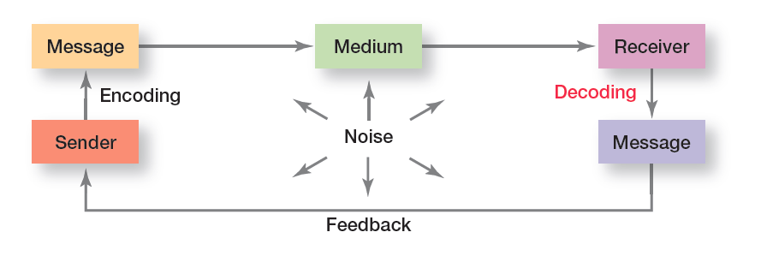
figura 14-1
Processo de comunicação interpessoal
14 - 9
Notes:
Exhibit 14-1 illustrates the elements of the communication process.

Slide 10
Comunicação não verbal
Comunicação não verbal
Comunicação transmitida sem palavras.
Linguagem corporal – gestos, expressões faciais e outros movimentos do corpo que transmitem significado.
Entoação verbal – tom e ênfase atribuído a palavras, que pode mudar o significado verbal.
14 - 10
Notes:
An important part of interpersonal communication is nonverbal communication— that is, communication transmitted without words. Some of the most meaningful communications are neither spoken nor written.
Body language refers to gestures, facial expressions, and other body movements that convey meaning. A person frowning “says” something different from one who’s smiling. Hand motions, facial expressions, and other gestures can communicate emotions or temperaments such as aggression, fear, shyness, arrogance, joy, and anger.
Verbal intonation refers to the emphasis someone gives to words or phrases in order to convey meaning. To illustrate how intonations can change the meaning of a message, consider the student who asks the instructor a question. The instructor replies, “What do you mean by that?” The student’s reaction will vary, depending on the tone of the instructor’s response. A soft, smooth vocal tone conveys interest and creates a different meaning from one that is abrasive and puts a strong emphasis on saying the last word.

Slide 11
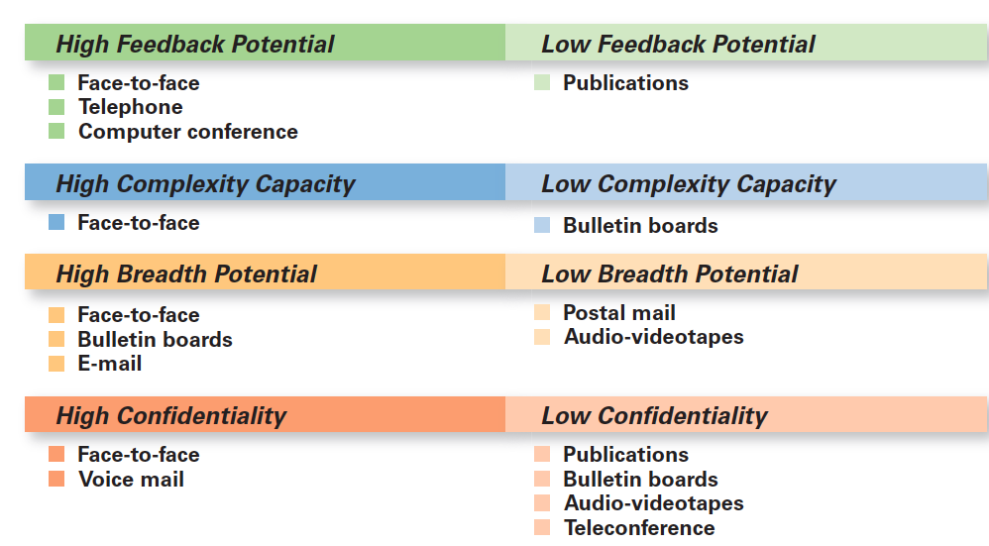
figura 14-2
Comparação de métodos de comunicação
14 - 11
Notes:
Exhibit 14-2 provides a comparison of various communication methods. Which method a manager ultimately chooses should reflect the needs of the sender, the attributes of the message, the attributes of the channel, and the needs of the receiver.

Slide 12
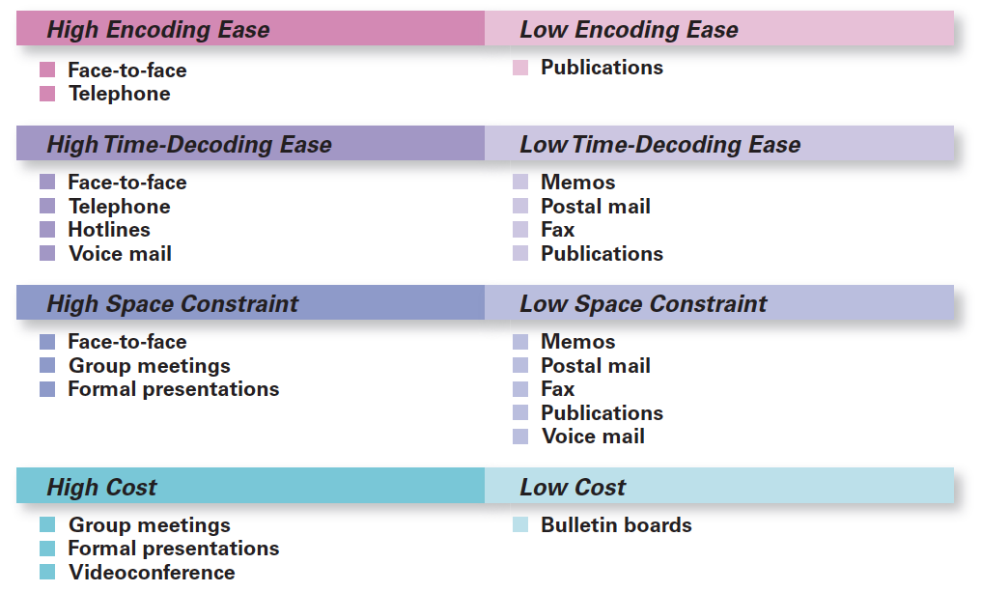
figura 14-2
Comparação de métodos de comunicação (cont.)
14 - 12

Slide 13
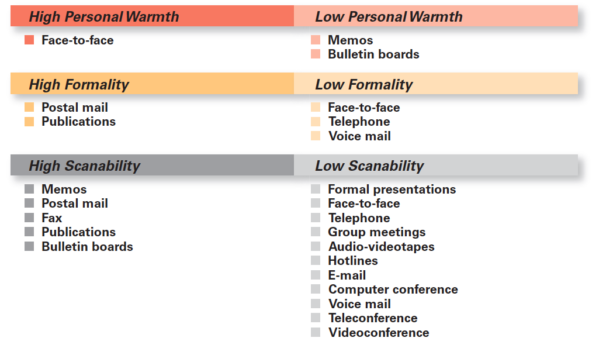
figura 14-2
Comparação de métodos de comunicação (cont.)
14 - 13

Slide 14
Barreiras à Comunicação
Filtragem – manipulação de informação para a tornar mais atraente para o recetor.
Excesso de informação – a informação que chega ao recetor excede a sua capacidade de processamento.
Significados diversos – As mesmas palavras podem ter significados diversos para diferentes pessoas de acordo com a sua idade, educação ou background cultural. Há também o caso de “gíria técnica” – i.e. linguagem técnica, apenas percebida por determinados grupos.
14 - 14
Notes:
Let’s look at barriers to effective communication:
Filtering is the deliberate manipulation of information to make it appear more favorable to the receiver. For example, when a person tells his or her manager what the manager wants to hear, information is being filtered. Or if information being communicated up through organizational levels is condensed by senders, that’s filtering.
It’s not possible to fully read and respond to each message without facing information overload, which is when information exceeds our processing capacity. Today’s employees frequently complain of information overload. Statistics show that 87 percent of employees use e-mail and that the average business e-mail user devotes 107 minutes a day to e-mail—about 25 percent of the workday.
In an organization, employees come from diverse backgrounds and have different patterns of speech. Even employees who work for the same organization but in different departments often have different jargon—specialized terminology or technical language that members of a group use to communicate among themselves.

Slide 15
Como ultrapassar as Barreiras
Utilizar o feedback para confirmar se o recetor percebeu.
Simplificar a linguagem, adequando-a às características da audiência.
Ouvir ativamente, sem fazer julgamentos prematuros.
14 - 15
Notes:
Many communication problems are directly attributed to misunderstanding and inaccuracies. These problems are less likely to occur if the manager gets feedback, both verbal and nonverbal. A manager can ask questions about a message to determine whether it was received and understood as intended.
Because language can be a barrier, managers should consider the audience to whom the message is directed and tailor the language to them. Remember, effective communication is achieved when a message is both received and understood.
Many of us are poor listeners. Why? Because it’s difficult, and most of us would rather do the talking. Listening, in fact, is often more tiring than talking. Unlike hearing, active listening, which is listening for full meaning without making premature judgments or interpretations, demands total concentration.

Slide 16
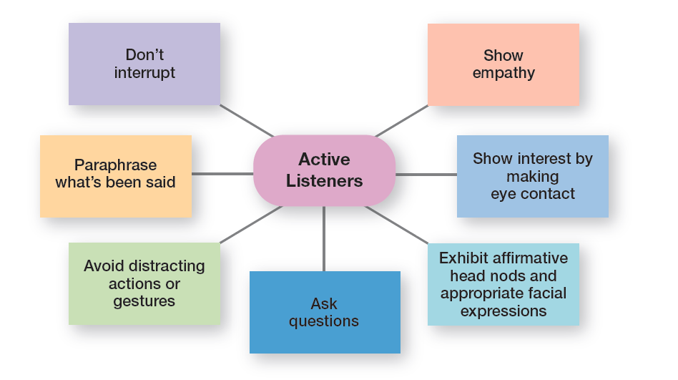
figura 14-3 comportamentos de escuta ativa
14 - 17
Notes:
An empathetic listener reserves judgment on the message’s content and carefully listens to what is being said. The goal is to improve one’s ability to get the full meaning of a communication without distorting it by premature judgments or interpretations. Other specific behaviors that active listeners demonstrate are listed in Exhibit 14-3. As you can see, active listening takes effort, but it can help make communication much more effective.

Slide 17
Comunicação formal e informal
Comunicação formal
Comunicação definida pela estrutura da organização.
Comunicação informal
Comunicação não prevista pela estrutura hierárquica da organização.
14 - 18
Notes:
Communication within an organization is described as formal or informal. Formal communication refers to communication that takes place within prescribed organizational work arrangements. For example, when a manager asks an employee to complete a task, that’s formal communication.
Informal communication is organizational communication not defined by the organization’s structural hierarchy. When employees talk with each other in the lunch room, as they pass in hallways, or as they’re working out at the company wellness facility, they engage in informal communication. Employees form friendships and communicate with each other. The informal communication system fulfills two purposes in organizations: (1) it permits employees to satisfy their need for social interaction, and (2) it can improve an organization’s performance by creating alternative, and frequently faster and more efficient, channels of communication.

Slide 18
Direção da Comunicação
Comunicação descendente
Comunicação dos gestores para os subordinados.
Exemplo:
Reuniões gerais informais – reuniões abertas a todos, onde a informação é transmitida e alguns assuntos podem ser debatidos. Também pode ser uma forma de juntar os empregados para celebrar algo.
14 - 19
Notes:
CEOs at companies such as Starbucks and Apple use town hall meetings to communicate with employees. These town hall meetings are informal public meetings where top executives relay information, discuss issues, or bring employees together to celebrate accomplishments. These are examples of downward communication which is communication that flows from a manager to employees. It’s used to inform, direct, coordinate, and evaluate employees.

Slide 19
Direção da Comunicação (cont.)
Comunicação ascendente – comunicação dos subordinados para os superiores.
Comunicação lateral – comunicação entre empregados do mesmo nível hierárquico.
Comunicação diagonal - comunicação que cria atalhos entre áreas de trabalho e níveis hierárquicos.
14 - 20
Notes:
Upward communication is communication that flows from employees to managers. It keeps managers aware of how employees feel about their jobs, their coworkers, and the organization in general. Managers also rely on upward communication for ideas on how things can be improved. Some examples of upward communication include performance reports prepared by employees, suggestion boxes, employee attitude surveys, grievance procedures, manager-employee discussions, and informal group sessions in which employees have the opportunity to discuss problems with their manager or representatives of top-level management.
Communication that takes place among employees on the same organizational level is called lateral communication. In today’s dynamic environment, horizontal communications are frequently needed to save time and facilitate coordination. Cross-functional teams, for instance, rely heavily on this form of communication interaction.
Diagonal communication is communication that crosses both work areas and organizational levels. A credit analyst who communicates directly with a regional marketing manager about a customer’s problem—note the different department and different organizational level—uses diagonal communication.

Slide 20
Redes de comunicação
Redes de comunicação – variedade de padrões de comunicação vertical e horizontal.
Rede de comunicação informal (grapevine) – conversas de corredor (radio-alcatifa), não previstas por mecanismos organizacionais.
14 - 21
Notes:
The vertical and horizontal flows of organizational communication can be combined into a variety of patterns called communication networks. In the chain network, communication flows according to the formal chain of command, both downward and upward. The wheel network represents communication flowing between a clearly identifiable and strong leader and others in a work group or team. The leader serves as the hub through whom all communication passes. Finally, in the all-channel network, communication flows freely among all members of a work team.
The grapevine is the informal organizational communication network. The grapevine is active in almost every organization. Is it an important source of information? You bet! One survey reported that 63 percent of employees say they hear about important matters first through rumors or gossip on the grapevine.

Slide 21
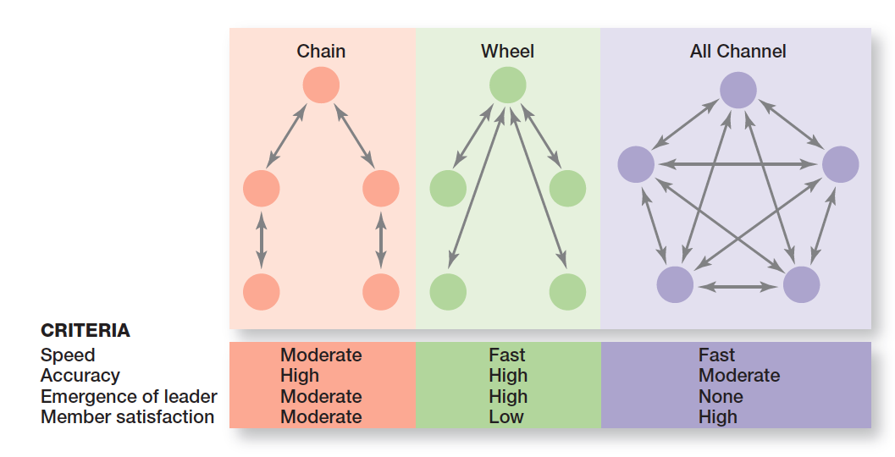
figura 14-4 redes de comunicação
14 - 22
Notes:
Exhibit 14-4 illustrates three common communication networks.

Slide 22
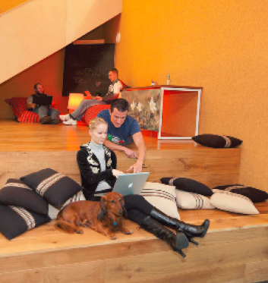
Desenho dos postos de trabalho e comunicação
Espaços abertos
(open space)
Postos de trabalho com poucas barreiras físicas.
14 - 23
Notes:
Many organizational workplaces today—some 68 percent—are open workplaces; that is, they include few physical barriers and enclosures. Research has shown both the merits and the drawbacks of an open workplace. One of the things we know for sure about this type of arrangement and its effect on communication is visibility. People in open cubicles placed along main routes of circulation or adjacent to atria reported almost 60 percent more face-to-face communication with team members than did those in lower-visibility locations. Another thing is density. More people populating an immediate work area meant that more face-to-face interactions took place.

Slide 23
Tecnologia e comunicação
Sistemas em rede – num sistema em rede os computadores duma organização estão ligados uns aos outros. Os membros da organização podem comunicar e enviar informação, quer estejam ao fundo do corredor ou do outro lado do planeta.
Ligações sem fios – a comunicação através da tecnologia wireless permite melhorar o trabalho dos gestores e dos empregados.
14 - 24
Notes:
IT has radically changed the way organizational members communicate. For example, it has significantly improved a manager’s ability to monitor individual and team performance, has allowed employees to have more complete information to make faster decisions, and has provided employees more opportunities to collaborate and share information. In addition, IT has made it possible for people in organizations to be fully accessible, any time, regardless of where they are. Employees don’t have to be at their desk with their computer running to communicate with others in the organization. Two IT developments that are most significant for managerial communication are networked systems and wireless capabilities.

Slide 24
Tópicos atuais de comunicação
Gerir a comunicação na Internet
  Problemas legais e de segurança
    Uso abusivo do e-mail
    Perda de confidencialidade e de informação privilegiado por causa da intervenção de hackers
  Faltas de interação pessoal
    Estar ligado não é a mesma coisa que o contacto pessoal
    Existem dificuldades de compreensão e colaboração no ambiente virtual
14 - 25
Notes:
Managers are learning, the hard way sometimes, that all this new technology has created special communication challenges. The two main ones are (1) legal and security issues, and (2) lack of personal interaction.

Slide 25
Comunicação e serviço ao cliente
Comunicar eficazmente com os clientes
  Reconhecer os três componentes do serviço ao cliente:
    O cliente
    A organização do serviço
    O fornecimento do serviço
14 -26
Notes:
What communication takes place and how it takes place can have a significant impact on a customer’s satisfaction with the service and the likelihood of being a repeat customer. Managers in service organizations need to make sure that employees who interact with customers are communicating appropriately and effectively with those customers.

Slide 26
Obter opiniões dos empregados
No ambiente atual as organizações necessitam obter informações/sugestões dos seus empregados.
Caixas de sugestões – são uma fonte de informação de elevado valor potencial.
14 - 27
Notes:
Companies need to get input from their employees. Have you ever worked somewhere that had an employee suggestion box? When an employee had an idea about a new way of doing something—such as reducing costs, improving delivery time, and so forth—it went into the suggestion box where it usually sat until someone decided to empty the box. Businesspeople frequently joked about the suggestion box, and cartoonists lambasted the futility of putting ideas in the employee suggestion box. And unfortunately, this attitude about suggestion boxes still persists in many organizations, and it shouldn’t. Managers do business in a world today where you can’t afford to ignore such potentially valuable information.

Slide 27
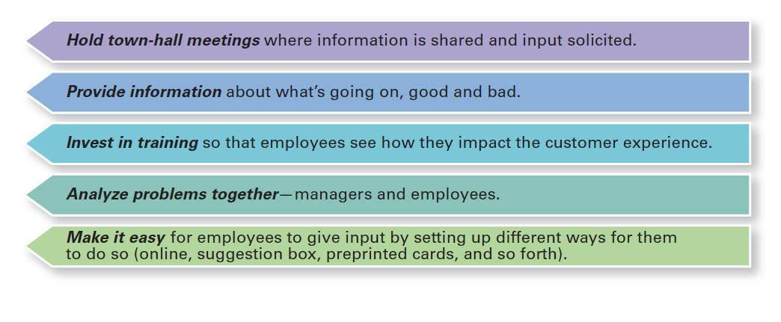
figura 14-5 como convencer os empregados que a opinião deles é importante
14 - 28
Notes:
Exhibit 14-5 lists some suggestions for letting employees know that their opinions matter.

Slide 28
Comunicação e ética
Comunicação ética
Comunicação que inclui toda a informação relevante, é completamente verdadeira, e não manipulativa.
14 - 29
Notes:
It’s particularly important today that a company’s communication efforts be ethical. Ethical communication “includes all relevant information, is true in every sense, and is not deceptive in any way.”
On the other hand, unethical communication often distorts the truth or manipulates audiences. What are some ways that companies communicate unethically? It could be by omitting essential information. For instance, not telling employees that an impending merger is going to mean some of them will lose their jobs is unethical.

Slide 29


